Slide 1
Layout

Slide 2
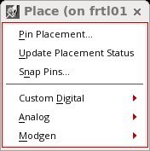
Pin placement
After placing blocks, next you plan and optimize pins in the layout.
Invoking Place menu : Select Window – Toolbar – Placement
1
2
3

Slide 3
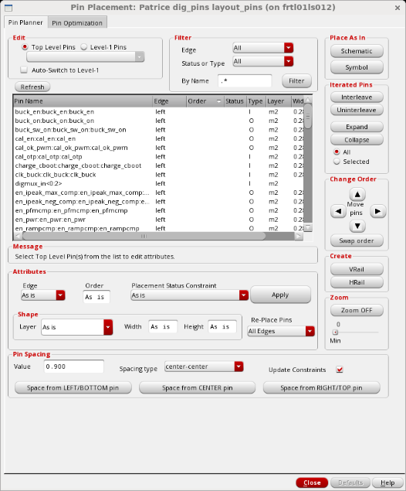
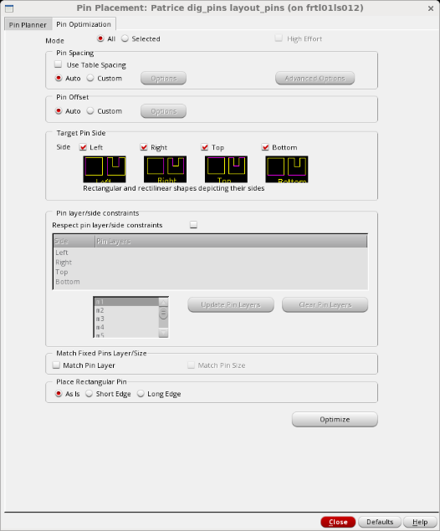
Use Pin placement form :
Form has 2 tabs :
Pin Planner
  To specify pin location constraints and pre-place pins
Pin Optimization
  To optimize your pins to achieve the shortest possible net length
1
2
1
2

Slide 4
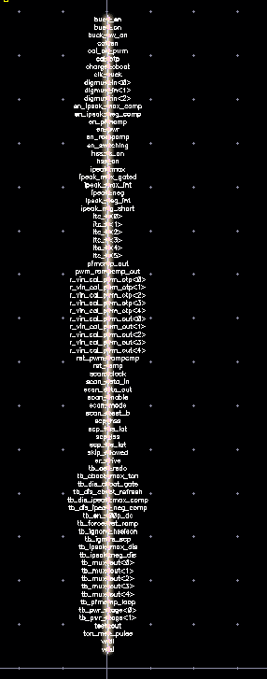
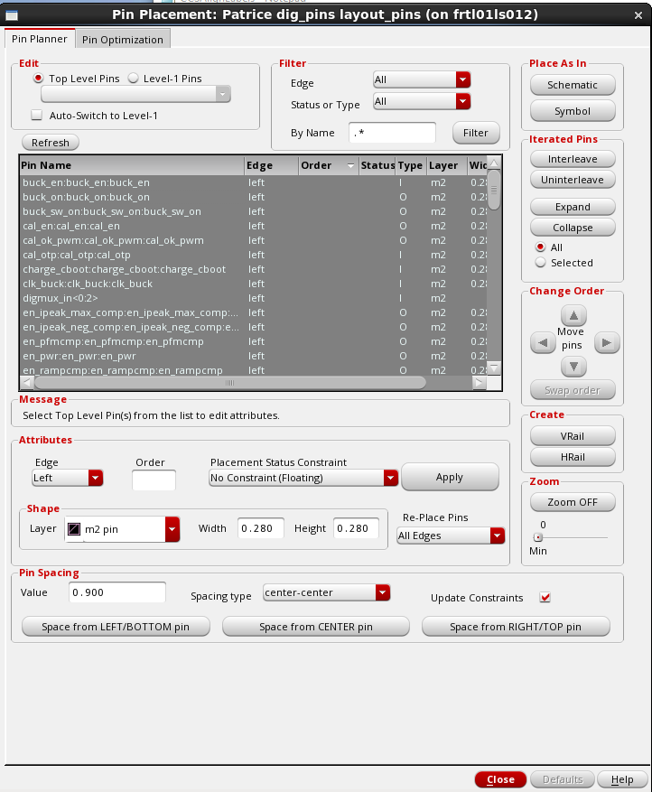
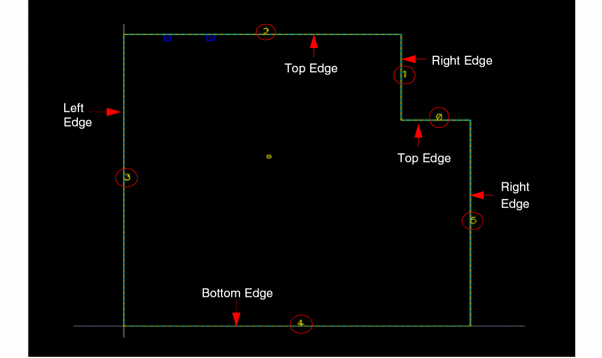
Pin Planner tab
Used to assign or redefine pin constraints and attributs :
Position
Spacing
Order
Place status (less, fixed)
1
3
2
4

Slide 5
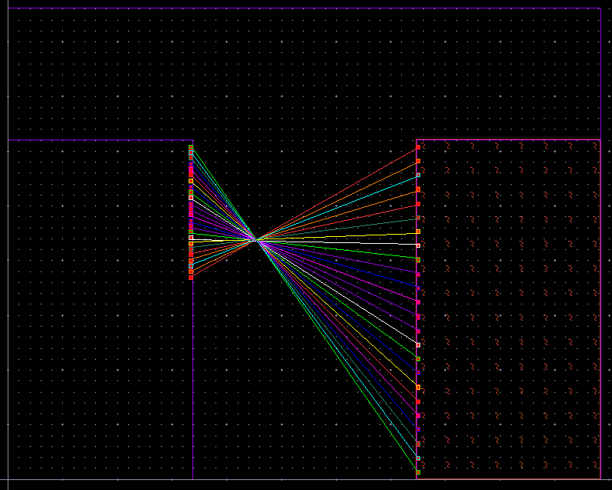
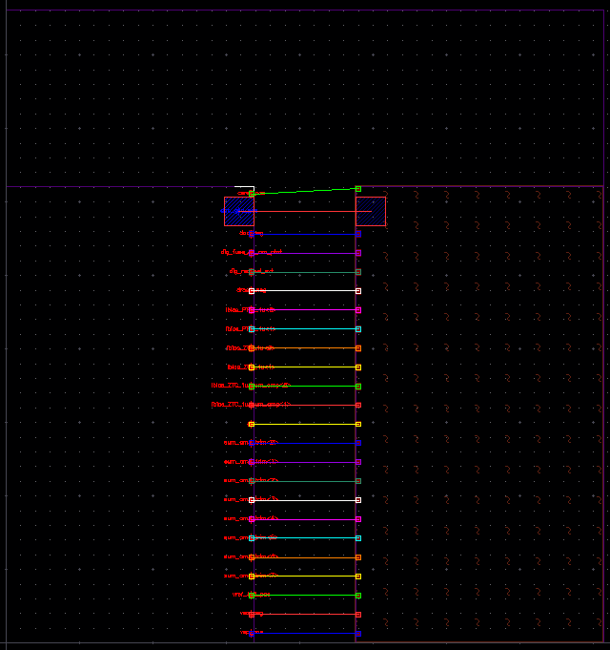
Align pin through hiearchy
Place -> Pin Placement
  Auto-Switch to Level -1
Pin Optimization
  All/Selected Move – All pins or just Pins Selected in the lower hierarchy
Select the pins in the softMacro from the current hierarchy
  Match Pin Layer
  Match Pin Size
Optimize

Slide 6
Filter options
“in.*” - Displays all the pins that have names starting with “in”.
“.*in.*” - Displays all the pins that contain “in” in their name.
“.*in” Displays all the pins that have names ending in “in”.
Default regular expression: “.*” - alpha numeric sort

Slide 7
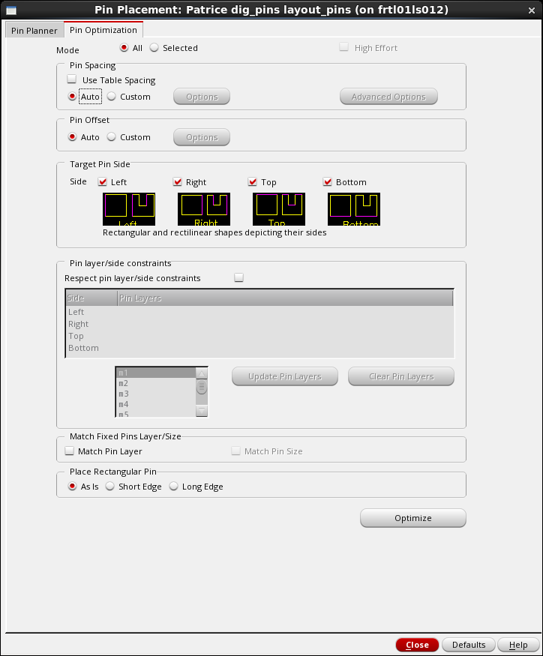
Pin Optimization Tab
It’s a powerfull algorithm that decides where to place pins in design, for optimal wire length and constraints (blockage, routing channel, DRC rules …).

Slide 8
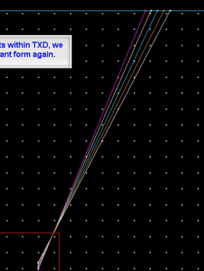
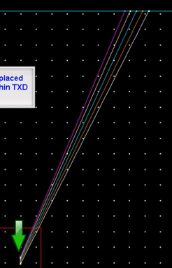
Twisted nets

Slide 9
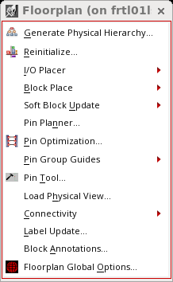
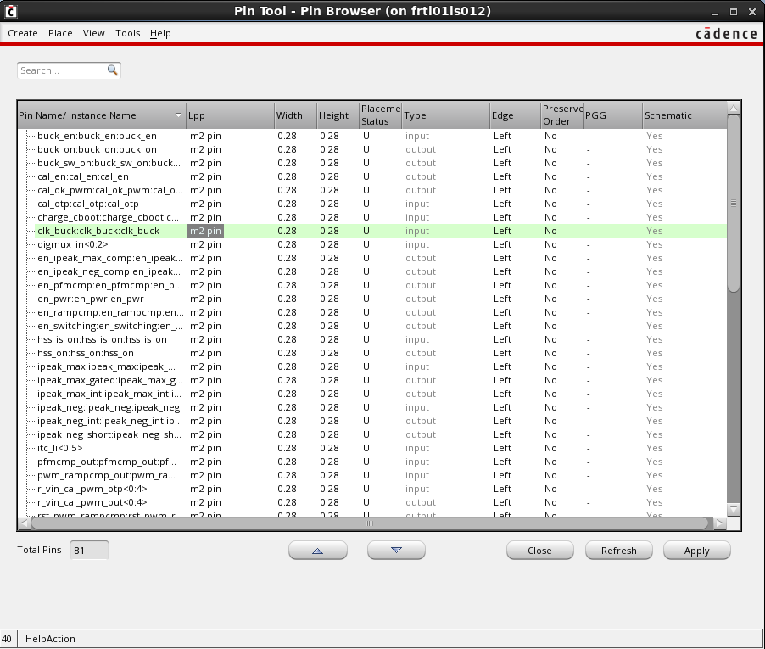
Virtuoso Floorplanner
Choose Floorplan – Pin Tool or click the Pin Tool button in the Floorplanning toolbar to launch the Pin Tool.
The Pin Browser lists all the pins that are available in the current layout design. The interface includes additional options to customize the display of pins

Slide 11
SKILL to place pins automatically in Layout
User define order and custom spacing value in a text file
load("CCSplacePinsInOrderAndSpacing.il")
To place pins with the same spacing, call the function in CIW after opening the concerned layout:
CCSplacePinsInOrderWithSameSpacing("./pinlist.txt" "Bottom" 0.5 0.3)
Where:
./pinlist.txt is the name of the text file which contains the pin names.
Bottom is the edge on which you want to place the pins. Other choices are Top, Left, and Right.
0.5 is the offset value for the first pin.
0.3 is the spacing value for all pins.

Slide 12
A sample pinlist.txt file is shown below. It should just have a pin name on each line. Identical spacing will be followed as specified with the command.
#PinName
a<1:4>
b<4:1>
c<1:2>
d<2:1>
c<3:4>
d<3:4>

Slide 13
Sorted / ordered pins ???
https://community.cadence.com/cadence_technology_forums/f/custom-ic-skill/38540/how-to-sort-a-list-alphanumerically-with-bus-names-in-descending-order-using-skill
sort a list alphanumerically

Slide 15
https://support.cadence.com/apex/ArticleAttachmentPortal?id=a1O3w00000AHHIBEA5&pageName=ArticleContent

